Slide 1
SMART VILLAGE
Guided By :-
Rakesh Varma
Hetash Patel
Prepared By :-
Pruthvi Soni
EnRoll :146050316024
Akil Shakih
EnRoll :146050316029
B&B Institude of Technology
Information Technology (IT)

Slide 2
CONTENTS AND GLANCES
PROJECT PROFILE
GUI OF WEBSITE
REFERENCES
SYSTEM REQUIREMENTS

Slide 3
PROJECT PROFILE
SMART VILLAGE
S ocial
M odern
A ware
R esponsive
T echnology
Ideal Village
Digital Village
Smart Village

Slide 4
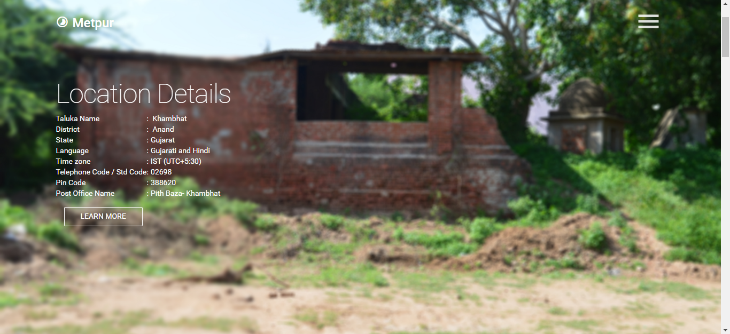
GUI OF WEBSITE
HOME PAGE

Slide 5
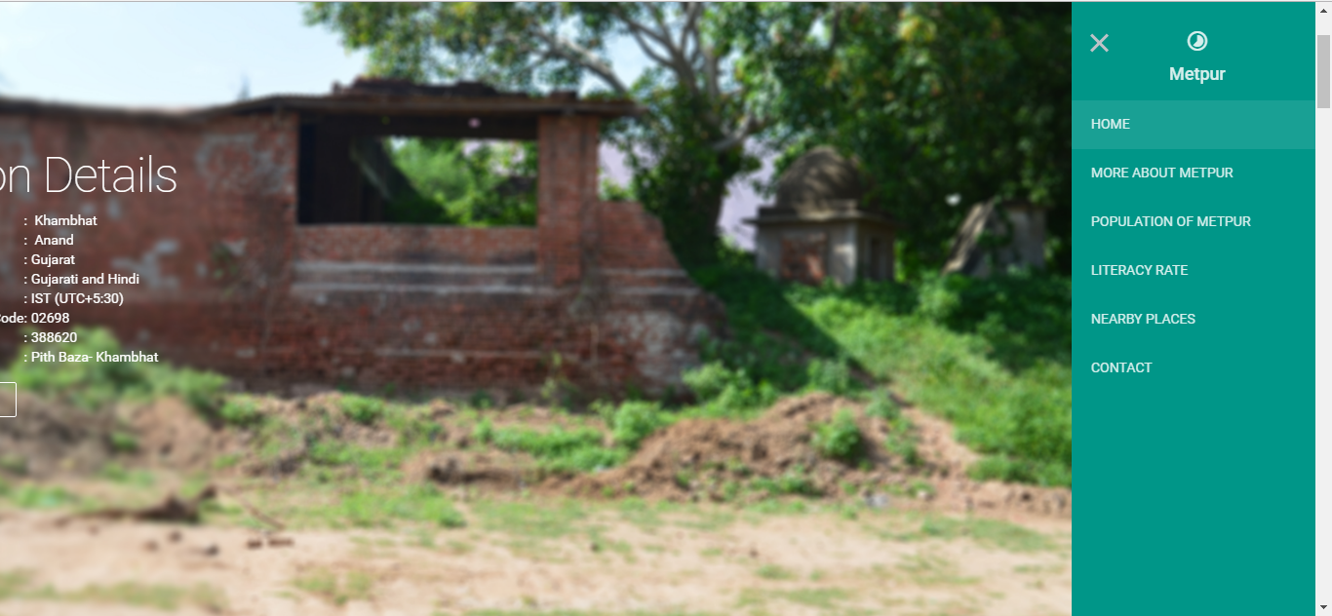
GUI OF WEBSITE
HOME PAGE WITH SLIDER

Slide 6
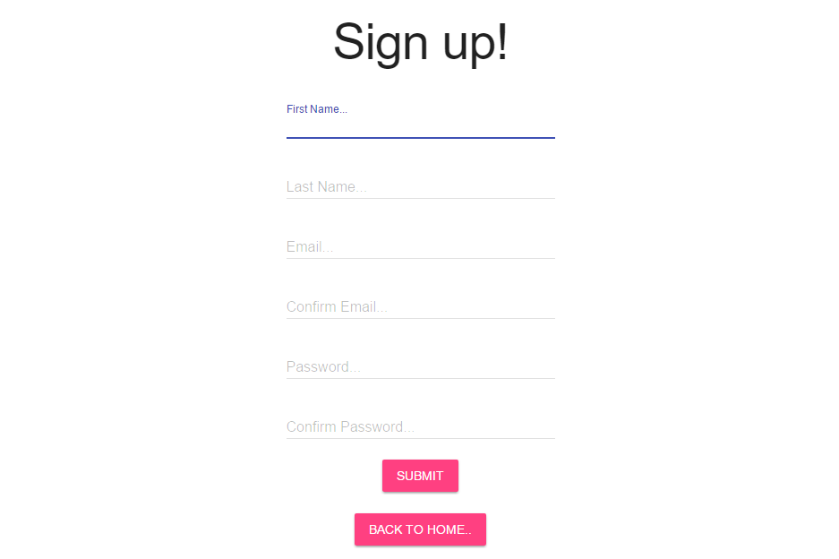
GUI OF WEBSITE
SIGN UP! PAGE

Slide 7
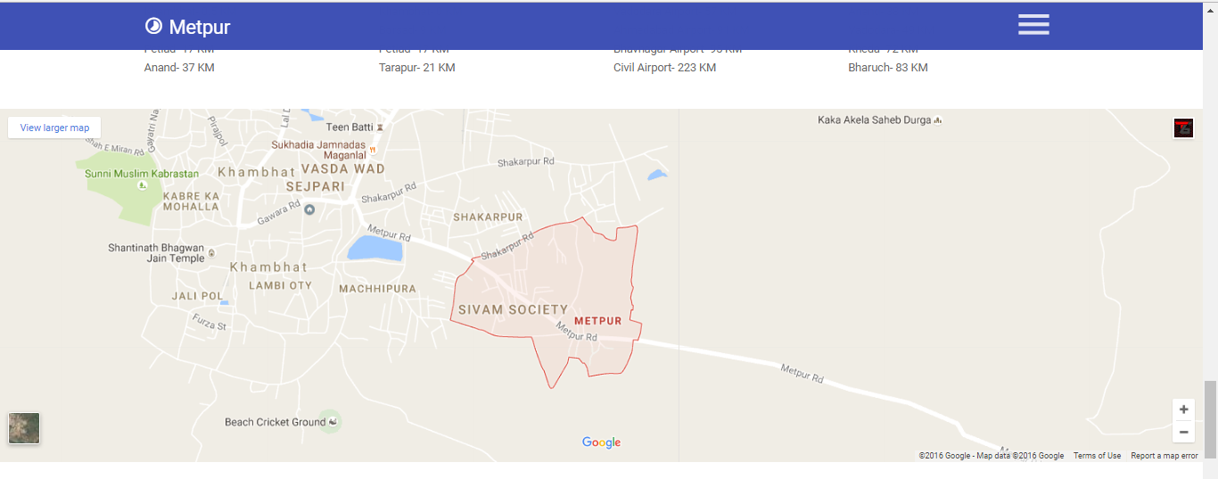
GUI OF WEBSITE
EMBEDDED GOOGLE MAP

Slide 8
REFERENCES
https://villageinfo.in
http://soki.in/
http://www.onefivenine.com/
http://www.wikivillage.in/

Slide 9
SYSTEM REQUIREMENTS
There are two ENTITYS..
USERS:
Sign! Up and Login.
Give reviews.
ADMIN:
Have a Full Control.
Active on the ouestion rases by user.
Maintain website up to date.

Slide 10
SYSTEM REQUIREMENTS
HAERDWARE & SOFTWARE REQUIREMENTS
Front-End: Google Chrome.
Back-End : Notepad ++Editor ,Atom Editor.
Documentation Tool : MS 2016.
Presentation Tool : MS POINT 2016.

